Slide 1
Spring Boot
Introduction to Spring Boot
Notes:
Add instructor notes here.

Slide 2

What is Spring Boot?
Spring Boot uses completely new development model to make Java Development very easy by avoiding some tedious development steps and boilerplate code and configuration.
It is a Framework developed on top of existing Spring Framework.
Spring Boot is a Framework from “The Spring Team” to ease the bootstrapping and development of new Spring Applications.
It provides defaults for code and annotation configuration to quick start new Spring projects within no time.
It follows “Opinionated Defaults Configuration” Approach to avoid lot of boilerplate code and configuration to improve Development, Unit Test and Integration Test Process.
Notes:
Add instructor notes here.

Slide 3
Advantages of Spring Boot
It is very easy to develop Spring Based applications with Java or Groovy.
It reduces lots of development time and increases productivity.
It avoids writing lots of boilerplate Code, Annotations and XML Configuration.
It is very easy to integrate Spring Boot Application with its Spring Ecosystem like Spring JDBC, Spring ORM, Spring Data, Spring Security etc.
It provides Embedded HTTP servers like Tomcat, Jetty etc. to develop and test our web applications very easily.
It provides CLI (Command Line Interface) tool to develop and test Spring Boot(Java or Groovy) Applications from command prompt very easily and quickly.
It provides lots of plugins to work with embedded and in-memory Databases very easily.
Notes:
Add instructor notes here.

Slide 4
System Requirements
By default, Spring Boot 1.4.3.RELEASE requires Java 7 and Spring Framework 4.3.5.RELEASE or above.
Servlet containers
Tomcat
Jetty
You can also deploy Spring Boot applications to any Servlet 3.0+ compatible container.

Slide 5
Installing Spring Boot
Maven installation
Spring Boot is compatible with Apache Maven 3.2 or above.
If you don’t already have Maven installed you can follow the instructions at maven.apache.org.

Slide 6
Developing your first Spring Boot application
Creating the POM
Writing the code
import org.springframework.boot.*;
import org.springframework.boot.autoconfigure.*;
import org.springframework.stereotype.*;
import org.springframework.web.bind.annotation.*;
@RestController
@EnableAutoConfiguration
public class Example {
@RequestMapping("/")
String home() {
return "Hello World!";
}
public static void main(String[] args) throws Exception {
SpringApplication.run(Example.class, args);
}
}

Slide 7
Developing your first Spring Boot application
The @RestController and @RequestMapping annotations
The first annotation on our Example class is @RestController. This is known as a stereotype annotation. It provides hints for people reading the code, and for Spring, that the class plays a specific role. In this case, our class is a web @Controller so Spring will consider it when handling incoming web requests.
The @RequestMapping annotation provides “routing” information. It is telling Spring that any HTTP request with the path “/” should be mapped to the home method. The @RestController annotation tells Spring to render the resulting string directly back to the caller.
The second class-level annotation is @EnableAutoConfiguration. This annotation tells Spring Boot to “guess” how you will want to configure Spring, based on the jar dependencies that you have added. Since spring-boot-starter-web added Tomcat and Spring MVC, the auto-configuration will assume that you are developing a web application and setup Spring accordingly.

Slide 8
Developing your first Spring Boot application
Running the applicaton
Type mvn spring-boot:run from the root project directory to start the application
$ mvn spring-boot:run
If you open a web browser to localhost:8080 you should see Hello World output in browser window.
To gracefully exit the application hit ctrl-c in command widnow.

Slide 9
Creating an executable jar
Executable jars (sometimes called “fat jars”) are archives containing your compiled classes along with all of the jar dependencies that your code needs to run.
To create an executable jar we need to add the spring-boot-maven-plugin to our pom.xml. Insert the following dependencies
<plugin>
<groupId>org.springframework.boot</groupId>
<artifactId>spring-boot-maven-plugin</artifactId>
</plugin>
run mvn package from the command line
If you look in the target directory you should see myproject-0.0.1-SNAPSHOT.jar.
To run that application, use the java -jar command:
$ java -jar target/myproject-0.0.1-SNAPSHOT.jar

Slide 10
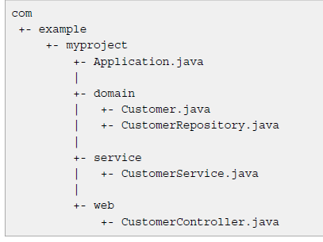
Structuring your code

Slide 11
Example
Mavan Goal to run the application
mvn spring-boot:run

Slide 12
@SpringBootApplication
@SpringBootApplication is a convenience annotation that adds all of the following:
@Configuration tags the class as a source of bean definitions for the application context.
@EnableAutoConfiguration tells Spring Boot to start adding beans based on classpath settings, other beans, and various property settings.
Normally you would add @EnableWebMvc for a Spring MVC app, but Spring Boot adds it automatically when it sees spring-webmvc on the classpath. This flags the application as a web application and activates key behaviors such as setting up a DispatcherServlet.
@ComponentScan tells Spring to look for other components, configurations, and services in the the hello package, allowing it to find the controllers.

Slide 13
Developing RESTful Web Services
@RestController
public class GreetingController {
private static final String template = "Hello, %s!";
private final AtomicLong counter = new AtomicLong();
@RequestMapping("/greeting")
public Greeting greeting(@RequestParam(value="name", defaultValue="World") String name) {
return new Greeting(counter.incrementAndGet(),
String.format(template, name));
}
}

Slide 14
Consuming RESTful Service
Accessing a third-party REST service inside a Spring application revolves around the use of the Spring RestTemplate class.
private static void getEmployees()
{
final String uri = "http://localhost:8080/springrestexample/employees.json";
RestTemplate restTemplate = new RestTemplate();
String result = restTemplate.getForObject(uri, String.class);
System.out.println(result);
}

Slide 15
Demo
Developing REST Service and Consuming it
Notes:
Add instructor notes here.

Slide 16
Spring Data JPA
What is Spring Data?
Spring Data is a high level project developed by Spring community aimed at simplifying the data access operations for the applications. There are several sub-projects maintained for the individual stores to have its own implementation of repositories.
If you are using Spring Data in your project, you are not going to write most of the low level data access operations like writing SQL query, DAO classes, etc. Spring Data will generate everything dynamically at run-time by creating the proxy instances of your abstract repositories and perform the required operations. What you write is the abstract interfaces that define the required operations.
Spring Data has the following sub-projects:
Spring Data Commons,,Spring Data MongoDB,Spring Data Redis,Spring Data Solr,Spring Data Gemfire,Spring Data REST

Slide 17
Spring Data JPA
Spring Data Repositories
The following are the three base interfaces defined in the spring data commons project.
The three base interfaces defined in the spring data commons project.
Repository
CRUD repository

Slide 18
Spring Data JPA
Repository
It is the central interface in the spring data repository abstraction. This is a marker interface. If you are extending this interface, you have to declare your own methods and the implementations will be provided by the spring run-time. For this interface also we have to pass two parameters:type of the entity and type of the entity’s id field. This is the super interface for CrudRepository.
CrudRepository
CrudRepository provides methods for the CRUD operations. This interface extends the Repository interface. When you define CrudRepository, you have to pass the two parameters: type of the entity and type of the entity’s id field. This interface has the following methods:
S save(S entity), T findOne(ID primaryKey),Iterable findAll(),Long count(),void delete(T entity),boolean exists(ID primaryKey)
If you are extending the CrudRepository, there is no need for implementing your own methods. Just extend this interface and leave it as blank. Required implementations are provide at run time.

Slide 19
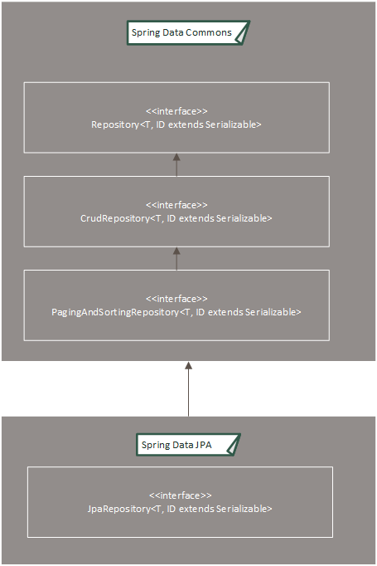
Spring Data JPA

Slide 20
Demo
Demo on Using CRUD Repository
Notes:
Add instructor notes here.

Slide 21
Spring MVC
@Controller
public class GreetingController
{ @RequestMapping("/greeting")
public String greeting(@RequestParam(value="name", required=false, defaultValue="World")
String name, Model model) {
model.addAttribute("name", name);
return "greeting";
}
}

Slide 22
Spring MVC
Greetings.html .
<!DOCTYPE HTML><html xmlns:th="http://www.thymeleaf.org">
<head>
<title>Getting Started: Serving Web Content
</title>
<meta http-equiv="Content-Type" content="text/html; charset=UTF-8" />
</head>
<body>
<p th:text="'Hello, ' + ${name} + '!'" />
</body>
</html>

Slide 23
Demo
Demo on developing MVC based application
Notes:
Add instructor notes here.

Slide 24
Spring Boot Testing
@RunWith(SpringRunner.class)
@SpringBootTest
@AutoConfigureMockMvcpublic
class ApplicationTest {
@Autowired private MockMvc mockMvc;
@Test public void greetingWithUser() throws Exception { mockMvc.perform(get("/greeting").param("name", "Greg")) .andExpect(content().string(containsString("Hello, Greg!"))); }
}

Slide 25
Demo
Demo on testing MVC based application
Notes:
Add instructor notes here.

Slide 26
Thanks

